Slide 1
Manchester
Raspberry Jam 22
August 2014

Slide 2
Last Time...

Slide 3
Manchester Raspberry Jam 21

Slide 4
In The News...

Slide 5
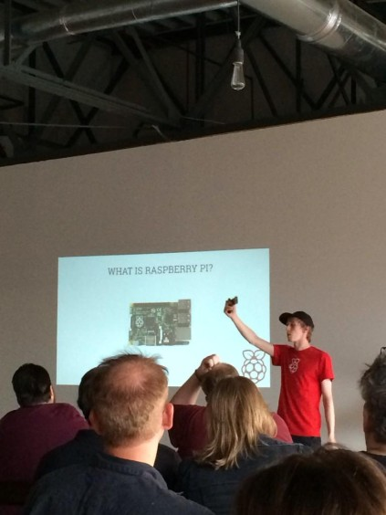
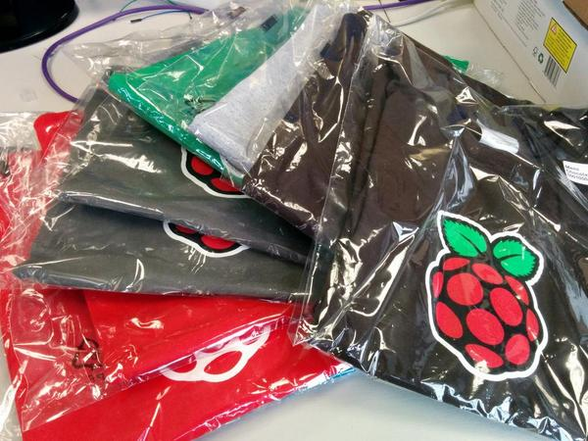
Ben’s US Tour
http://www.raspberrypi.org/bens-mega-usa-tour/

Slide 6
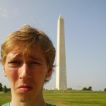



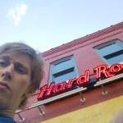
Ben’s US Tour
http://www.raspberrypi.org/bens-mega-usa-tour/

Slide 7
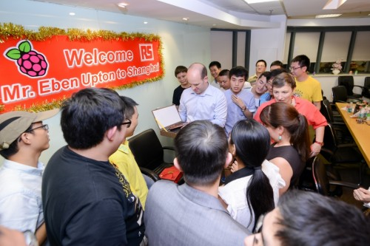
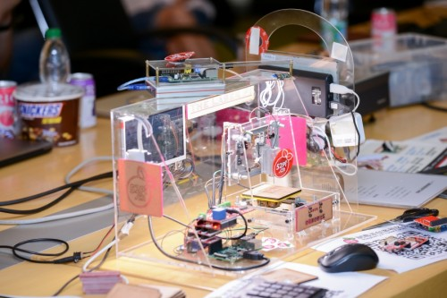
Liz and Eben’s China tour
http://www.raspberrypi.org/china-tour/

Slide 8
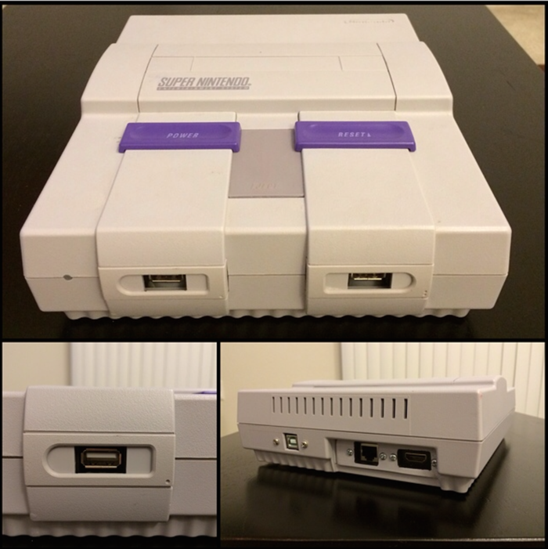
PiGamer - Pi games console
https://www.kickstarter.com/projects/pigamer/raspberry-pi-gamer-console

Slide 9
PiGamer - Pi games console
https://www.kickstarter.com/projects/pigamer/raspberry-pi-gamer-console

Slide 10
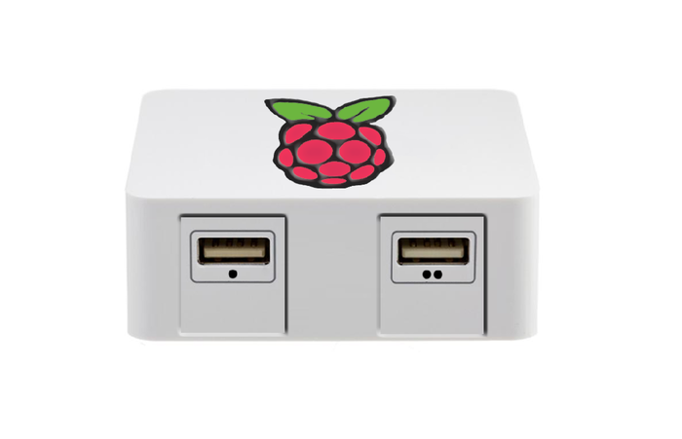
PiGamer - Pi games console
https://www.kickstarter.com/projects/pigamer/raspberry-pi-gamer-console

Slide 11
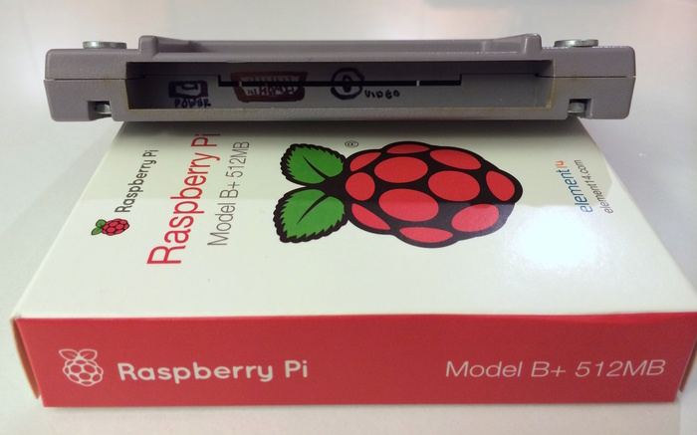
PiGamer - Pi games console
https://www.kickstarter.com/projects/pigamer/raspberry-pi-gamer-console

Slide 12
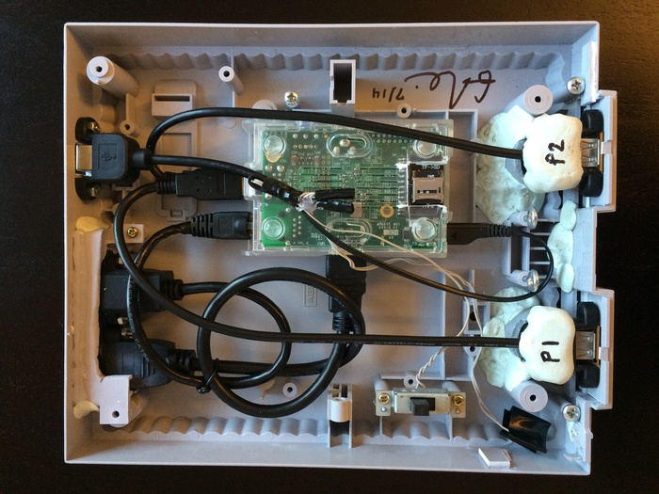
PiGamer - Pi games console
https://www.kickstarter.com/projects/pigamer/raspberry-pi-gamer-console

Slide 13
Projects...

Slide 14
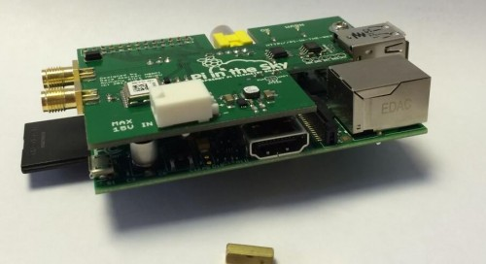
Pi in the sky - Addon board
http://www.raspberrypi.org/pi-in-the-sky-2/

Slide 15
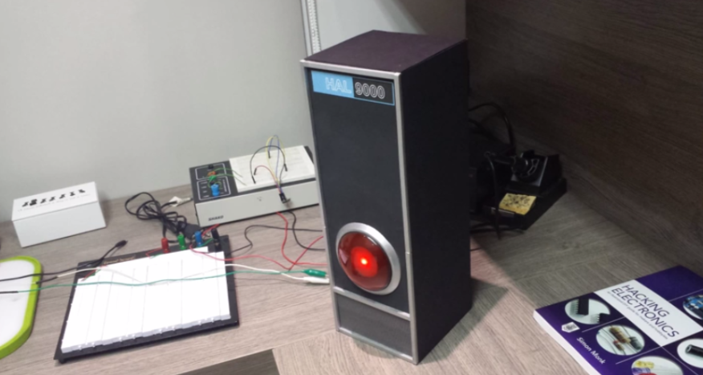
I’m sorry dave, I’m afraid I can’t do that
https://learn.adafruit.com/pigrrl-raspberry-pi-gameboy?view=all

Slide 16
Coming soon...

Slide 17
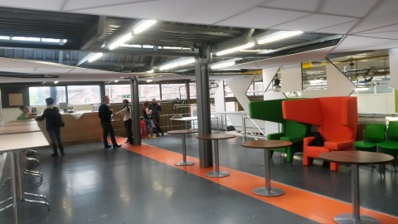
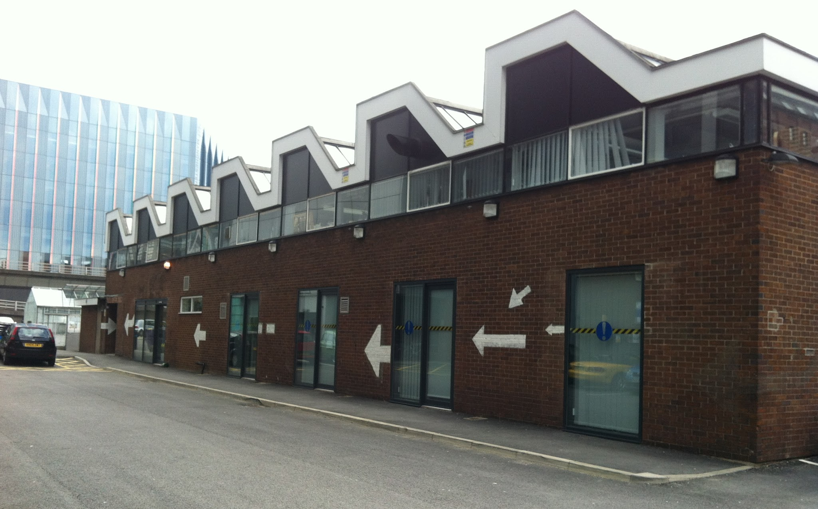

Manchester Raspberry Jam 22

Slide 18
For today...

Slide 19
Today:
Pizza at 1pm
WiFi:
MMU-Visitor
University

Slide 20
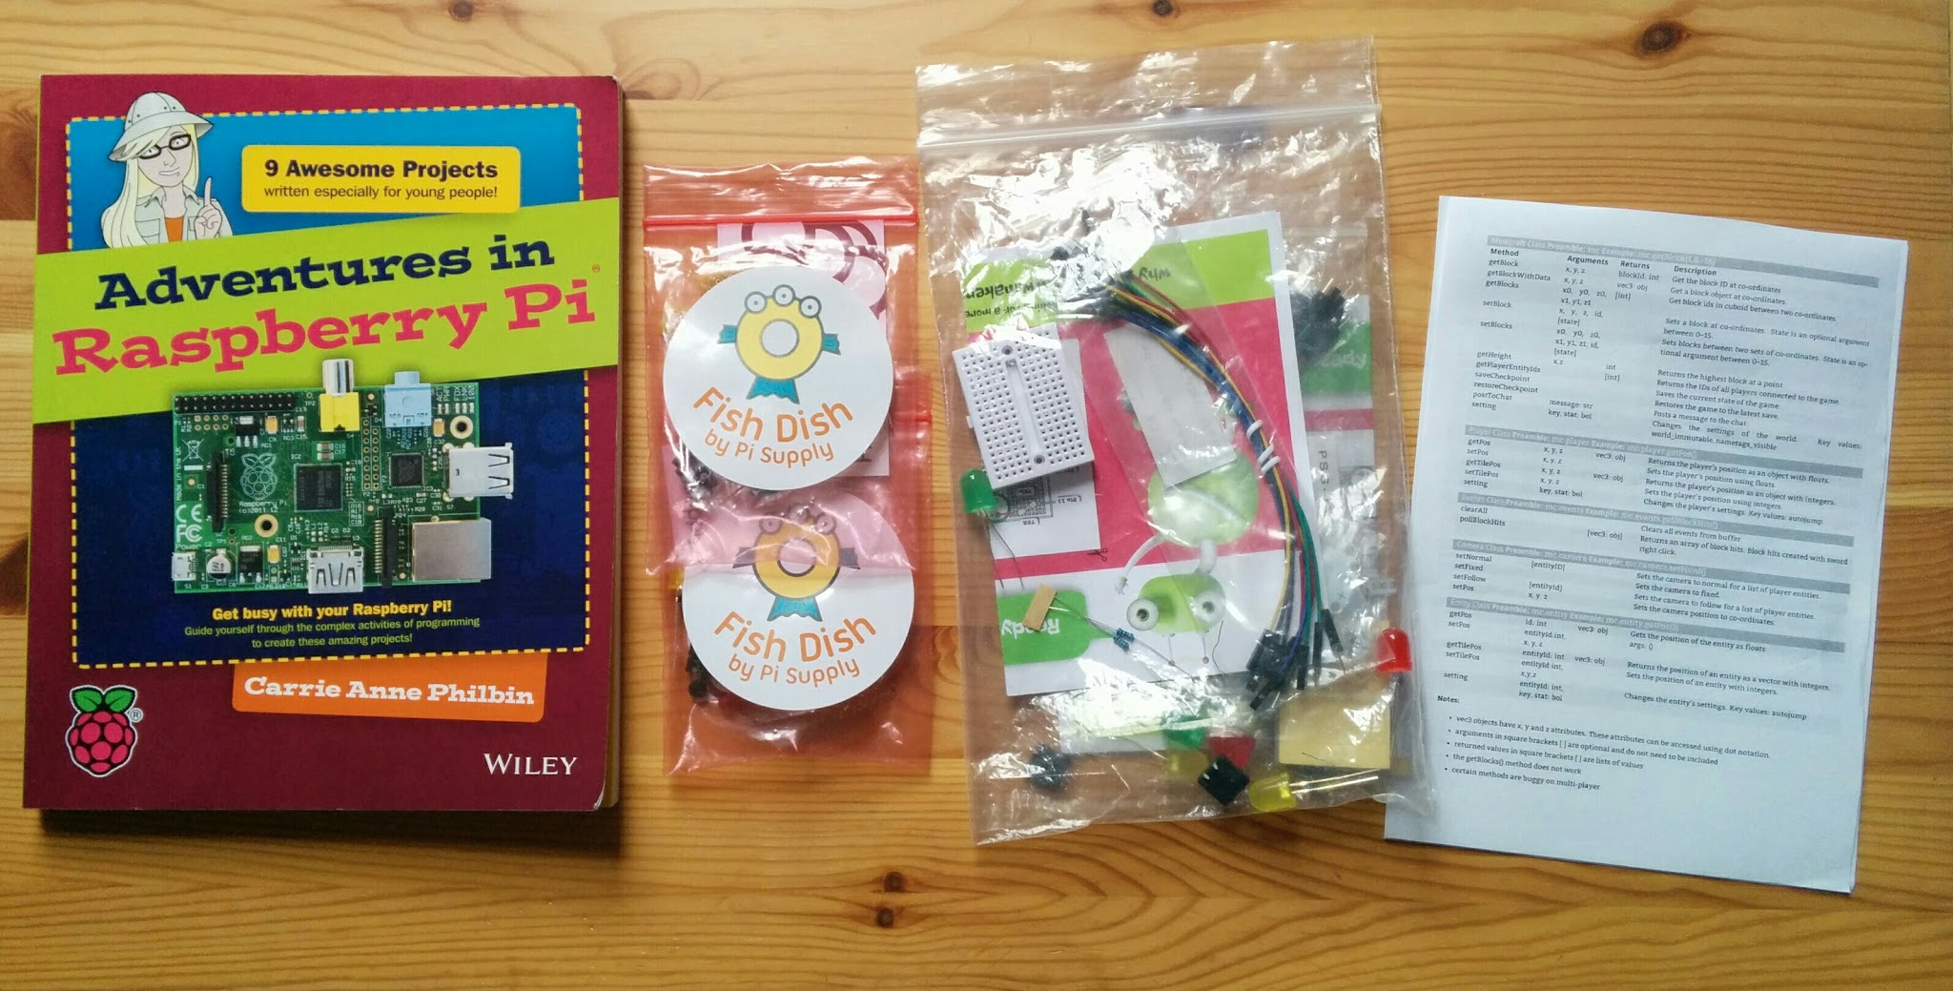
Stuck for ideas?
http://www.raspberrypi.org/introducing-raspberry-pi-model-b-plus/

Slide 21
Thanks to our sponsors:
Stephen Blythe
Chris Davies
Dave Jones
Pete Lomas
Tyrone McIvor
Simon Walters

Slide 22
Finally...
Tweet your photos and creations:
#McrRaspJam
Download the slides:
http://bit.ly/McrRaspJam22

